Slide 1

Statistical Method for Handling Zeros in Microbiome Data
Mingyang Chen
Ashleigh Chen
David Li

Slide 2

Outline
Introduction
16S rRNA sequence
OTU(operational taxonomic units)
Phylogenetic Tree
Zeros
Literature review
four methods (what have we done)
A novel data generator
Parameter setting
Three Scenario

Slide 3
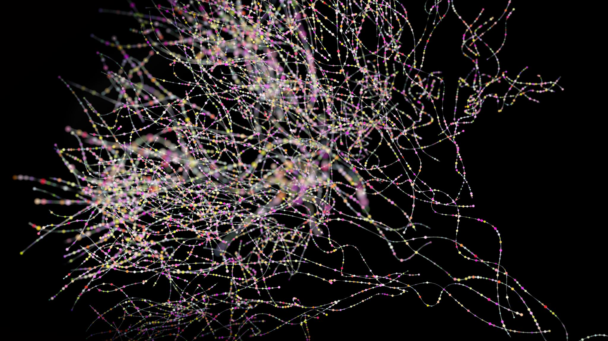
Introduction
Ashleigh Chen

Slide 4
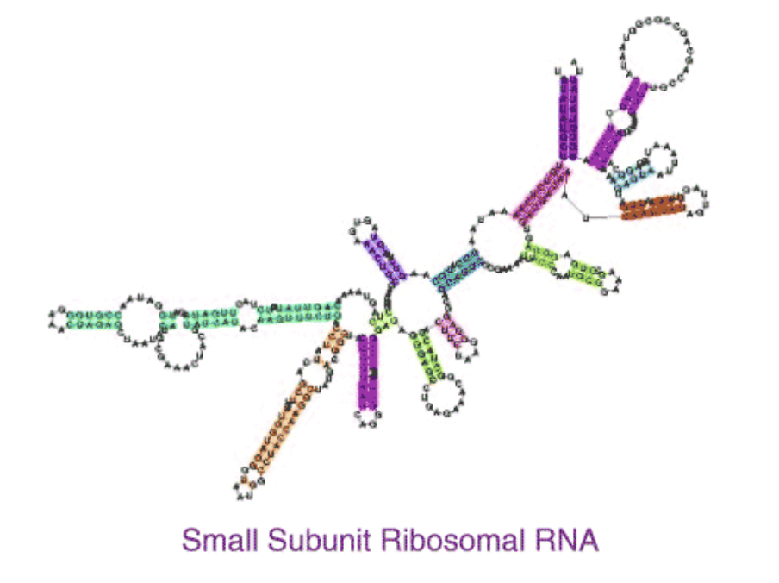
16S rRNA Sequence
Highly conserved
Highly variable
Cheap but not perfect
Sensitive detection

Slide 5
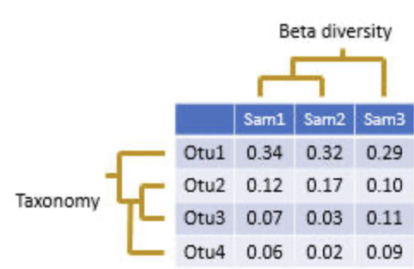
Operational Taxonomic Units (OTUs)
Taxonomy of 16S rRNA
High dimensionality
Non-linearity

Slide 6
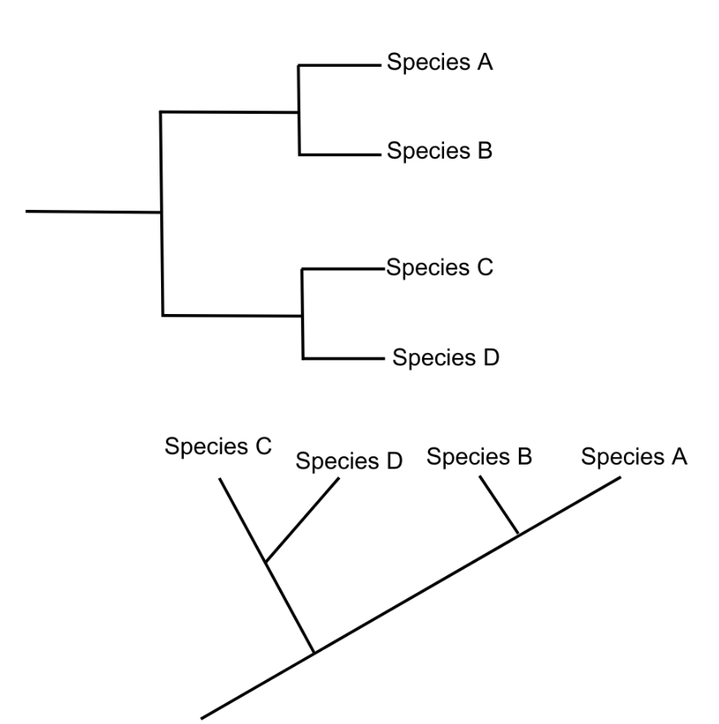
Phylogenetic Tree
Evolutionary tree
Binary-based
Distance-based

Slide 7
Zeros
Sampling zeros:
taxa cannot be detected due to the technology or the depth of data sequence
smaller abundance rate
Biological zeros:
Truly absent from the system

Slide 8

Challenge
High dimensional data
Compositional data
Zero-inflation
No covariates

Slide 9
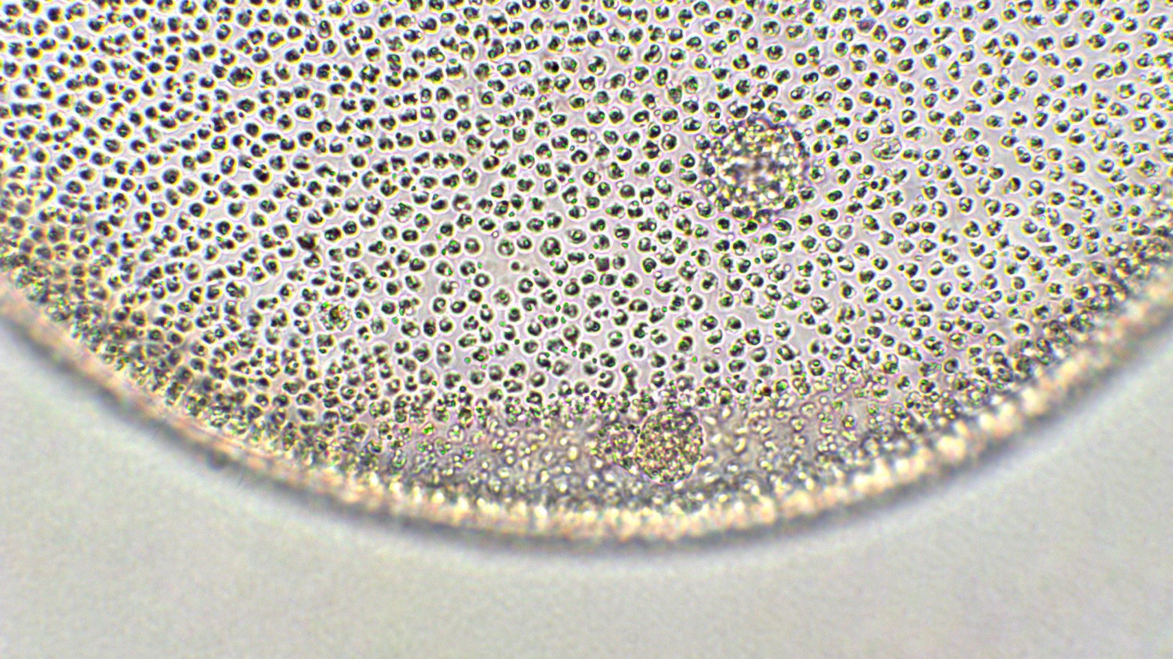
Four Methods(Literature review) what has been done?
David li

Slide 10

Bayesian –Multiplicative replacement method (Mart ́ın-Fern ́andez et al.)
All zeros in microbiome data set are treated as the results of the insufficiently large samples, and all of them are called “sampling zeros”.
Not use phylogenetic tree.

Slide 11
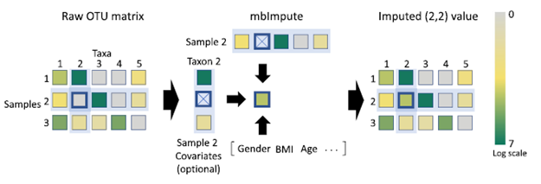
MbImpute Jiang et al. in 2021 [9].
-MBImpute identifies likely non-biological zeros
-it imputed these zeros by borrowing information from similar taxa, similar microbiome samples.

Slide 12

Zero inflated probabilistic PCA model (Zeng et al. in 2022)
It employs an empirical Bayes approach in estimating microbial compositions
A unique classification variational approximation algorithm embedded in this method simplifies the execution of maximum likelihood estimations.

Slide 13

Zero inflated Dirichlet tree multinomial model(Zhou et al. In 2021)
First, extending the Dirichlet-tree multinomial (DTM) to zero-inflated DTM
Within this framework under a Bayesian formulation, converting raw counts into non-zero relative abundances

Slide 14
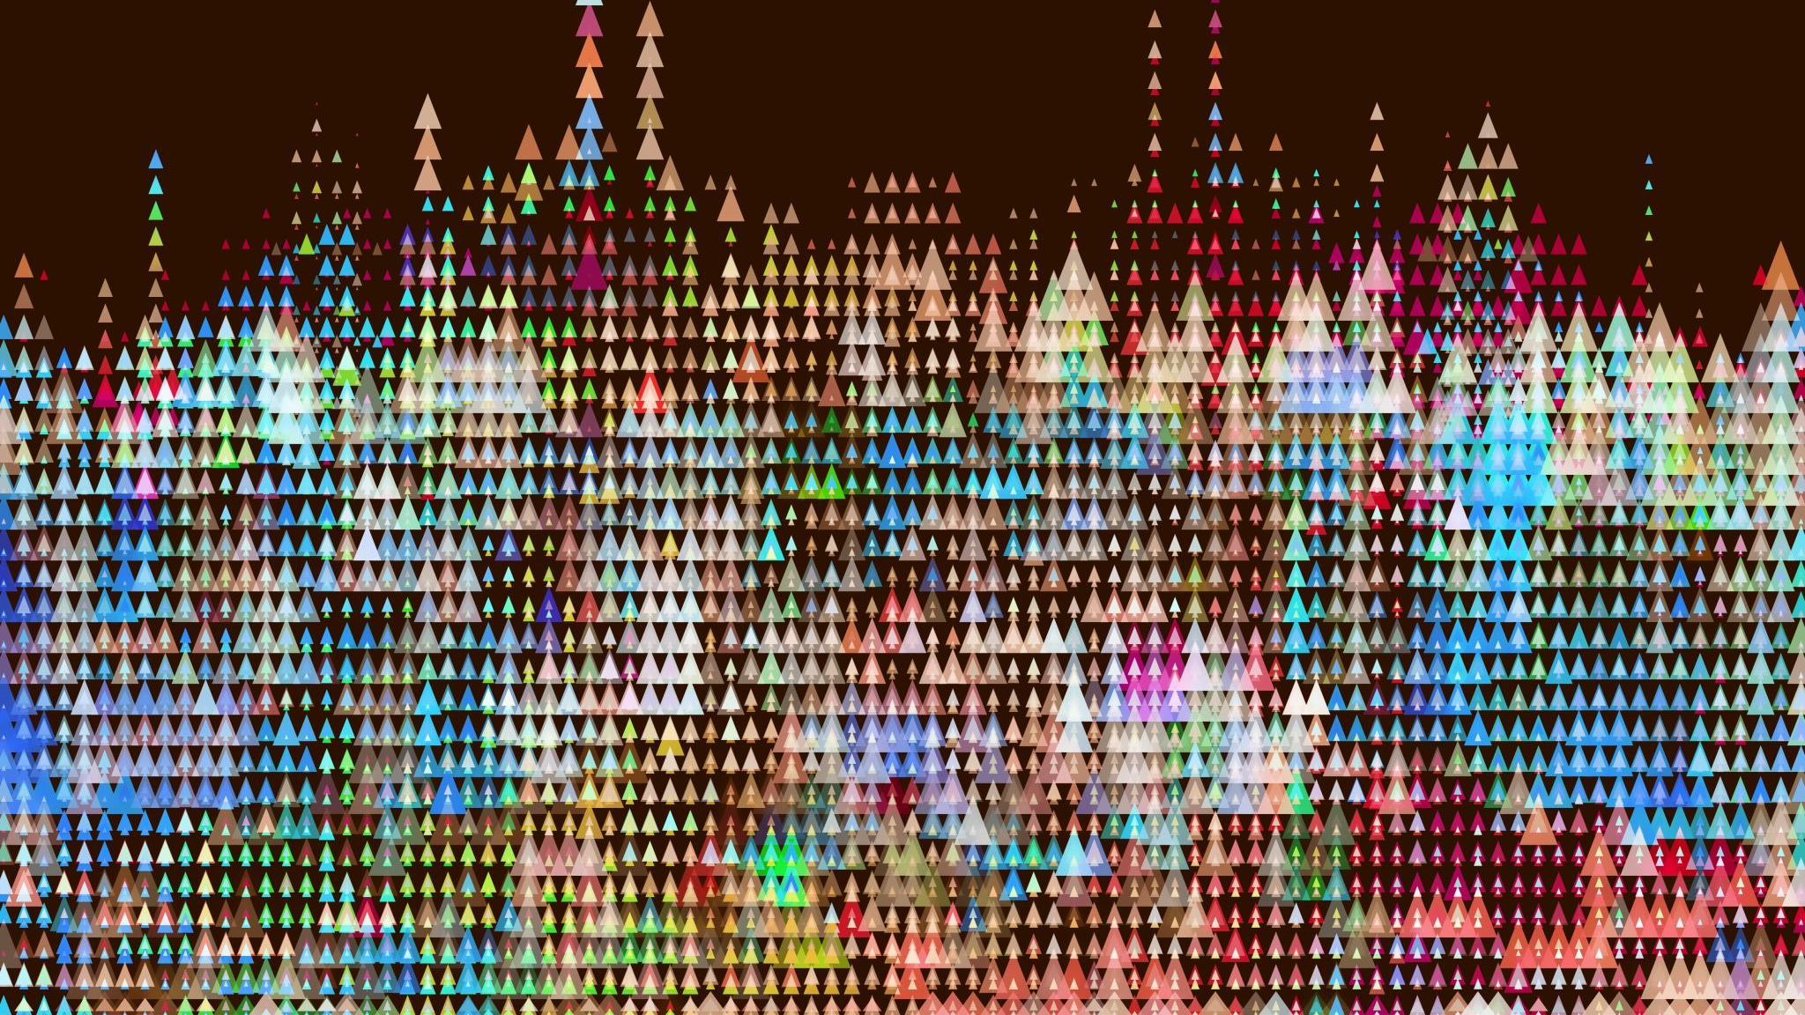
Data Generation
Mingyang Chen

Slide 15
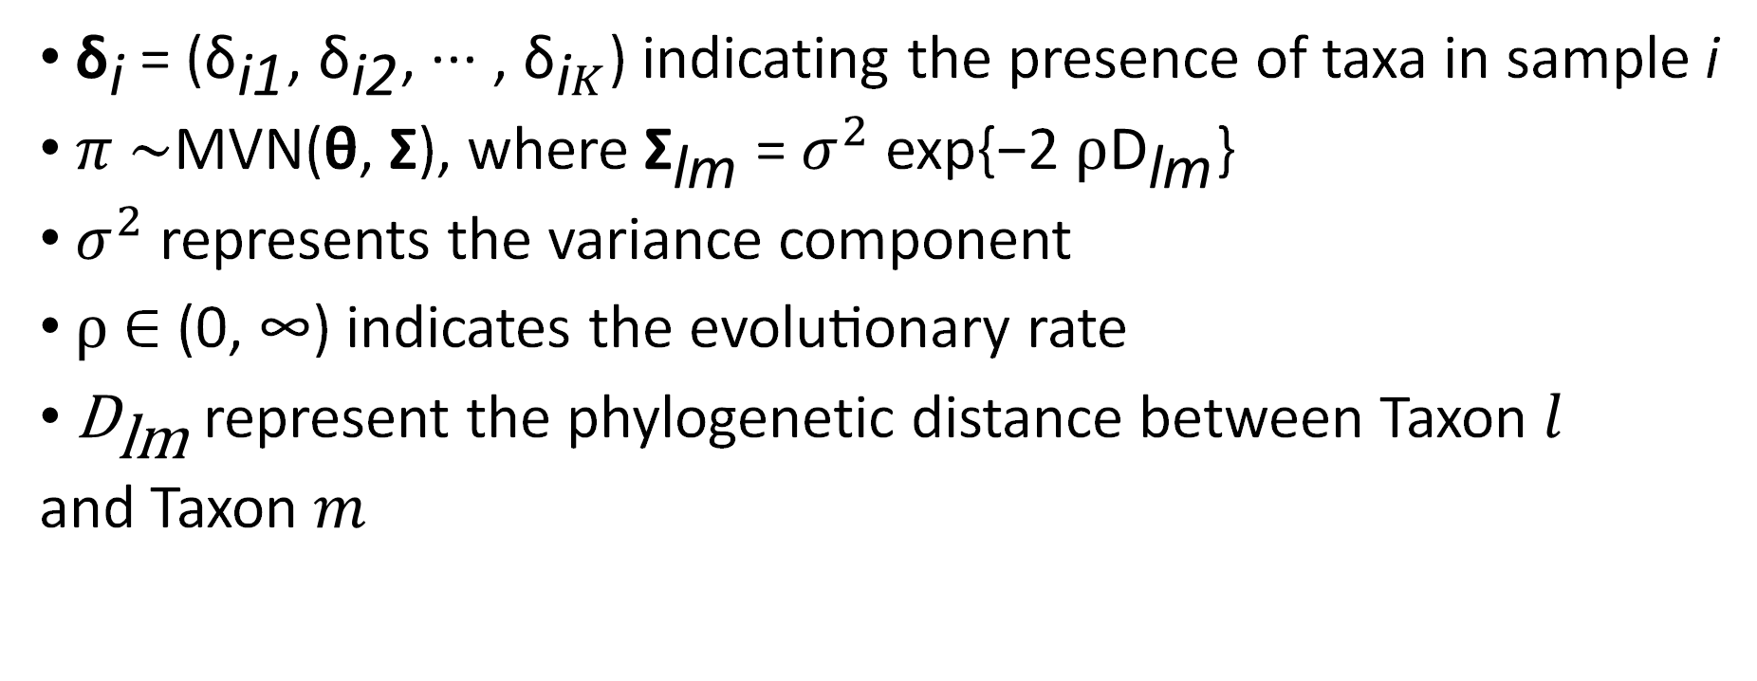
Data generation
${\text{δ}}_{\text{i}}$= (${\text{δ}}_{\text{i}\text{1}}$, ${\text{δ}}_{\text{i}\text{2}}$, ··· , ${\text{δ}}_{\text{i}K}$) indicating the presence of taxa in sample i
$π$ ∼MVN(θ, Σ), where ${\text{Σ}}_{\text{lm}}$ = $σ^{2}$ exp{−2 $ρ{\text{D}}_{\text{lm}}$}
$σ^{2}$ represents the variance component
$ρ$∈ (0, ∞) indicates the evolutionary rate
${\text{D}}_{\text{lm}}$ represent the phylogenetic distance between Taxon $l$
and Taxon $m$

Slide 16
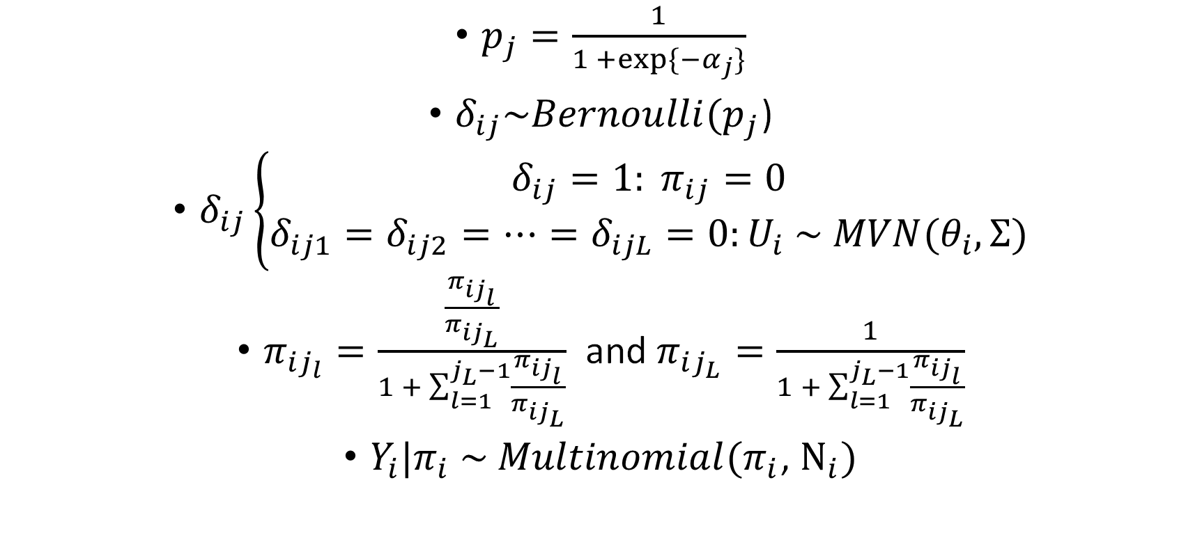
Data generation
$p_{j}=\frac{1}{1 +exp⁡\{{−α}_{j}\}}$
$δ_{ij}\sim Bernoulli(p_{j}$)
$δ_{ij}\left\{\begin{aligned}δ_{ij}=1: π_{ij}=0 \\ δ_{ij1}=δ_{ij2}=…=δ_{ijL}=0:U_{i} \sim MVN(θ_{i}, Σ)\end{aligned}\right.$
$π_{ij_{l}}=\frac{\frac{π_{ij_{l}}}{π_{ij_{L}}}}{1 + \sum_{l=1}^{j_{L}−1}{\frac{π_{ij_{l}}}{π_{ij_{L}}}}}$ and $π_{ij_{L}}=\frac{1}{1 + \sum_{l=1}^{j_{L}−1}{\frac{π_{ij_{l}}}{π_{ij_{L}}}}}$
$Y_{i}|π_{i} \sim Multinomial(π_{i}$, $N_{i})$

Slide 17
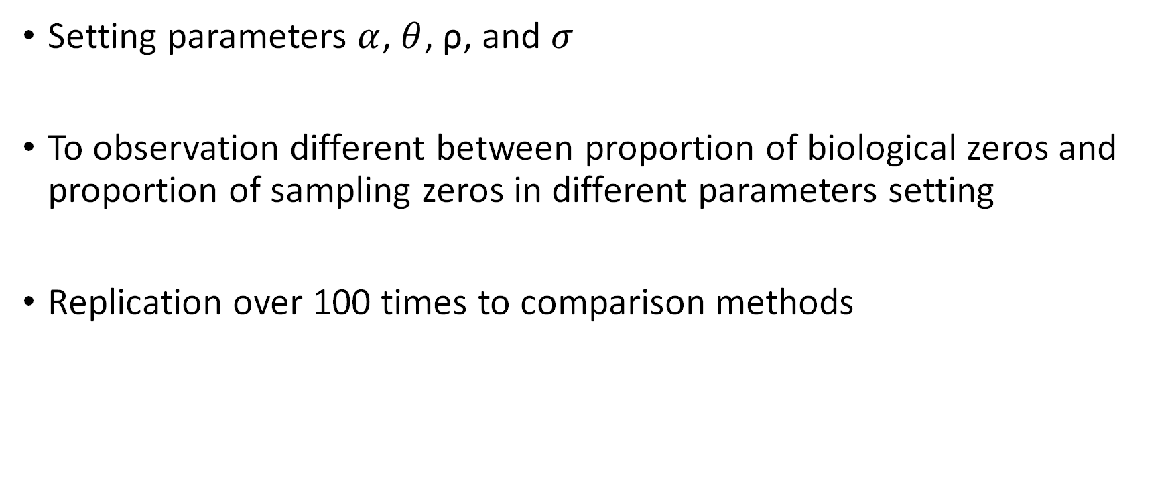
Data generation – parameter comparison
Setting parameters $α$, $θ$, $\text{ρ}$, and $σ$
To observation different between proportion of biological zeros and proportion of sampling zeros in different parameters setting
Replication over 100 times to comparison methods

Slide 18

What things should we compare among four method?
Frobenius Norm Error
MSE Squared Error
Wasserstein Distance Error

Slide 19
Reference
Four methods:
• Martín-Fernández et al.: Bayesian-multiplicative replacement
method (zComposition)
• Jiang et al.: Gamma-Normal mixture model (mbImpute)
• Zhou et al.: Zero-inflated Dirichlet tree multinomial model
(ZIDTM)
• Zeng et al.: Zero-inflated probabilistic PCA model (ZIPPCA)

Slide 20
Thank you for watching!!

